Slide 1
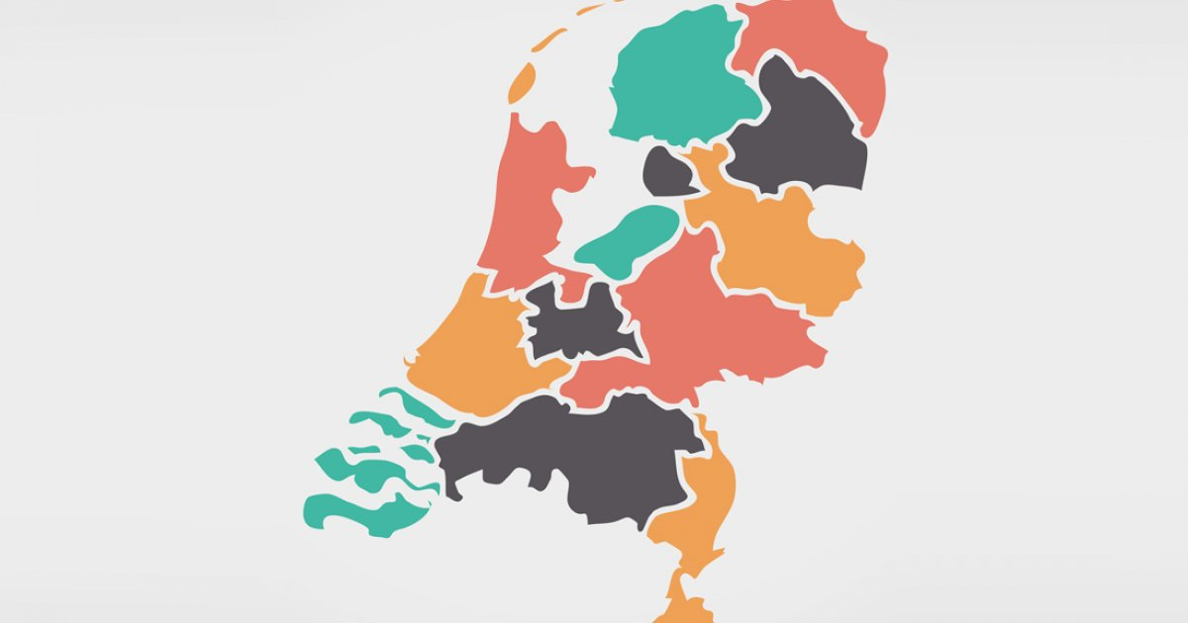
ENERGY CONSUMPTION IN NETHERLANDS
Group Omega
Shivani Kolungade
Neeti Panjwani
Sarvesh Prabhu

Slide 2
INRODUCTION
Enexis, Liander, and Stedin are the three major network administrators of the Netherlands and, together, they provide energy to nearly the entire country.
We will be concentrating on the company Enexis Electricity and Gas.

Slide 3
BUSINESS QUESTIONS
How are the smart meters spreading?
What is the overall energy consumption by the Enexis over the years?
What are the factors responsible for the changes in energy consumption?

Slide 4





INSTALLATION

Slide 5
About the Dataset
1 Million rows
Data Preprocessing
city: Name of the city
zipcode: range of zipcode for the city
num_connections: Number of connections in the range of zipcodes
perc_of_active_connections: Percentage of active connections in the zipcode range
type_conn_perc: percentage of presence of the principal type of connection in the zipcode range
annual_consume: Annual consume. Kwh for electricity, m3 for gas
smartmeter_perc: percentage of smartmeters in the zipcode ranges
year: data is spread over 10 years from 2010 to 2019
Dropped the columns with no significant data
Merged the files based on the year
Concentrated on Enexis’s Electricity and Gas Consumption separately

Slide 6
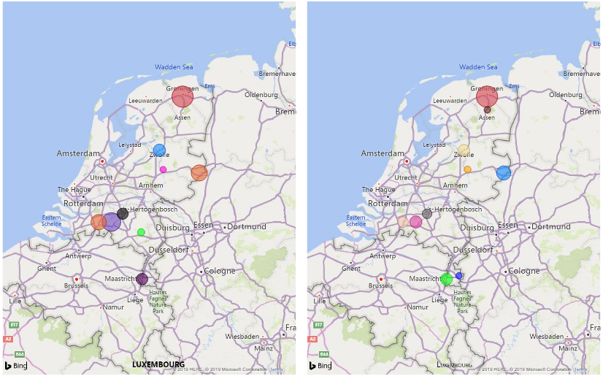
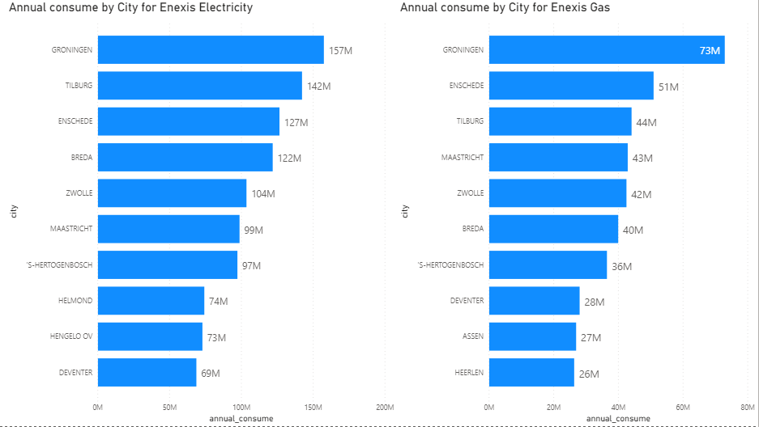
The overall annual Energy consumption of Electricity in top 10 cities of the Netherlands.

Slide 7
The overall annual Energy consumption of Gas in top 10 cities of the Netherlands.

Slide 8
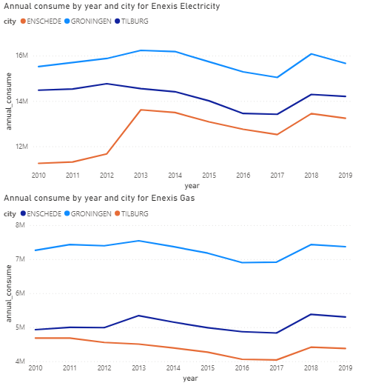
Line chart to show the energy consumption trends in Top 3 cities

Slide 9
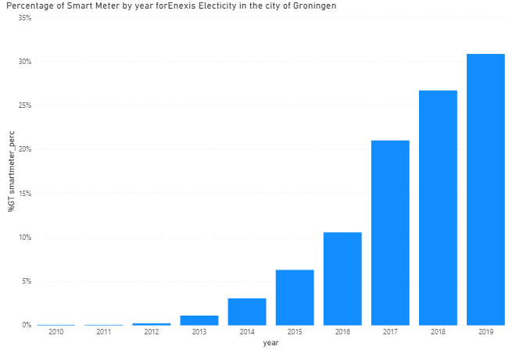
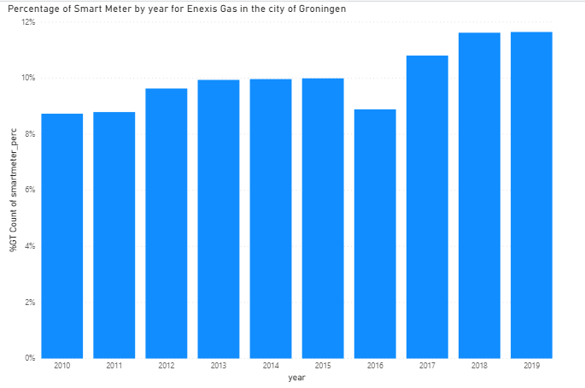
Smart meter percentage in the city of Groningen over the years

Slide 10
CONCLUSION
The total electricity consumption has been roughly constant over the years except for their major city Groningen.
While the number of connections growing linearly, so the consumption per connection in cities seemingly decreased, because of using more energy efficient products such as LEDs and awareness of saving energy everywhere.
Its observed that number of smart meters have increased tremendously over the years.
So, we can conclude that, if Enexis will deploy more smart meters in Groningen followed with other cities in the Netherlands, it will help them increasing their revenue.
Smart meters will give them slot data that will help them monitoring the consumption patterns of energy for their customers and generate bills accordingly. With the help of these smart meters, every user can have control over energy consumption and save environment.

